Slide 1

CEG-4110 Introduction to Software Engineering April 9,2024
Hana Tollossa – Team Lead
Alexander Hooper
Ethan Timpe
Jahcorian Ivery
Varshitha Thanam

Slide 2
Outline
Elevator Speech
Requirements
Architecture
Entity Relationship Diaram
App Pages
Conclusion/Review
Question

Slide 3
Elevator Pitch
Budgeting App
Mobile App
Savings goals
Tracks money usage
Simple UI
Persistent Data
Simple way manage money

Slide 4
Requirements
The app shall allow users to track their monthly income and expenses through user input.
The app shall allow users to log in with a username and password pair.
The app shall salt and hash user passwords to ensure basic security.
The app shall allow users to create accounts with their first name, last name, username, email, and password.
The app shall allow users to edit the first name, last name, username, and email of their account.

Slide 5
Requirements (Continued)
The app shall store and retrieve and display income and expense data for multiple users.
The app shall allow users to plan large purchases by calculating monthly savings based on the total price and desired goal date.
The app shall be supported on iOS devices.
The app shall be supported on Android devices.

Slide 6
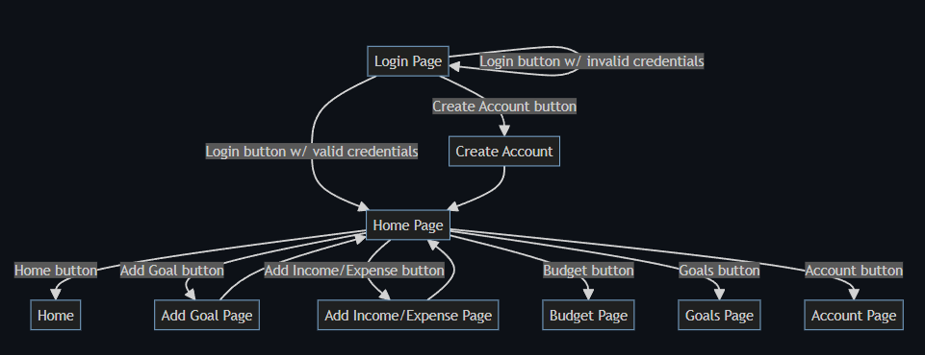
Architecture

Slide 7
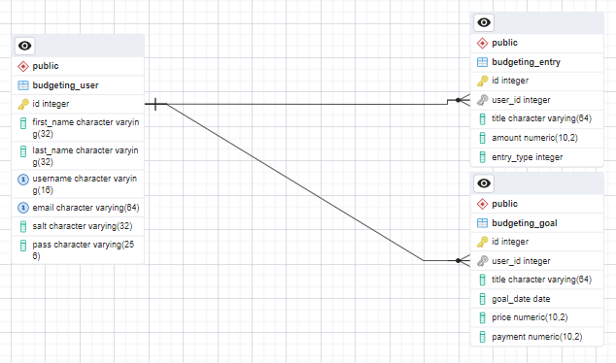
Entity Relationship Diagram

Slide 8
Create Account Page
Allows users to create accounts using fields:
First Name
Last Name
Username
Email
Password
Confirm Password
Checks that username and email do not already exist
Hashes (SHA-256) and salts password before sending record to database

Slide 9
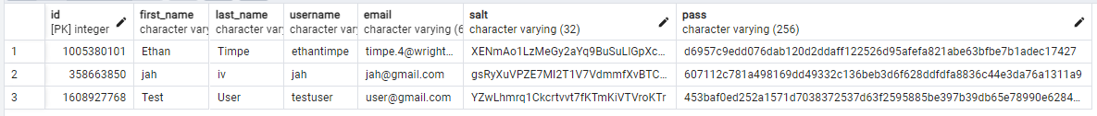
Login Page
Limits access until logged in
Checks that username exists
If yes, hashes the password with the associated salt and check that it matches
If username doesn't exist or password doesn't match, displays error message

Slide 10
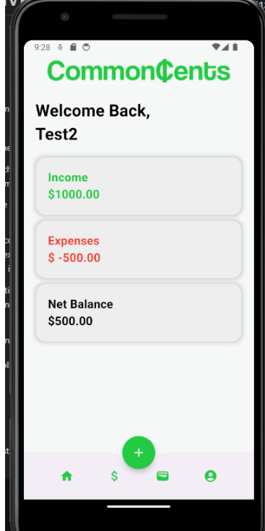
Home Page
Display who is logged in.
Summary of user account
Income
Expenses
Net Balance

Slide 11
Budget Page:
List of transactions of a user account
Monthly Budget
Keeps track of the monthly expenses
Income
Net money of the user
Expenses
Monthly expenses are shown in red
To add an income or expense for the month, simply use the '+' button

Slide 12
Goals

Slide 13
Goal/Plan
Goals Page
Shows your current goals.
Goal card
Shows the current amount, the projected end date, and the suggested monthly payment.
Adding goal page
Accessed through middle + button
Lets you set a goal name, amount, and end date.

Slide 14
Account Page
Allows users to edit their account information
First Name
Last Name
Username
Email
Checks that new username and password are available
Sends UPDATE request to database

Slide 15
Conclusion/Review
Budgeting mobile App
It allow users track their money usage and set saving goals.
It have simple user-friendly UI with persistent data.
It is unique way of money manage system.

Slide 16

Questions?

